Slide 1
INDUCTION COURSE FOR NEW ACADEMIC STAFF
PREPARED BY : Jean Damascene HAKIZIMANA
CBA Verifier Officer
On 28th November, 2024

Slide 2

Competency Based Training Planning

Slide 3
Learning objectives:
By the end of this session participants will be able:
To describe correctly planning steps used used in CBT/CBA
To Prepare correctly a scheme of work as used in CBT/CBA
To Prepare a session plan adequately as Used in CBT/CBA

Slide 4
Activity:
Read the material given and discuss in group
Ater discussion in home group you will present the material in Expert team
You will spend 15 in Home group and 15 in expert team

Slide 5
Failing to plan is planning to fail, what do you understand by SMART Planning ?

Slide 6
PLANNING
SMART Planning
SMART planning is a goal-setting framework that helps ensure objectives are clear, achievable, and measurable. The acronym SMART stands for Specific, Measurable, Achievable, Relevant, and Time-bound. This method encourages setting precise and well-defined goals (Specific), using concrete criteria to track progress (Measurable), ensuring the goal is realistic and within reach (Achievable), aligning the goal with broader priorities and values (Relevant), and establishing a clear timeline for completion (Time-bound). By adhering to the SMART criteria, individuals and teams can create focused, actionable plans that increase the likelihood of success and provide clear direction for achieving desired outcomes.

Slide 7
WHAT IS COMPETENCE BASED TRAINING PLANING
Competence-based training planning focuses on developing specific skills and competencies required for a particular job or role. It involves identifying the key abilities and knowledge needed, setting clear learning objectives, and designing training programs that help individuals acquire these competencies. The goal is to ensure that trainees gain practical, measurable skills that directly apply to their work, improving performance and productivity.

Slide 8
Planning is an advanced arrangement of doing things. Planning includes;
Selecting and organizing subject matter to be taught
Choosing the teaching method
Prepare teaching resources
Outline procedures to be followed
Putting time available into consideration

Slide 9
Importance of planning
Importance of planning is to:
Help in better organization in curriculum material
Ensure that relevant material and procedures are considered in teaching
Help to identify needs
Allow the trainer to become resourceful
Give opportunities for continuous personal growth

Slide 10
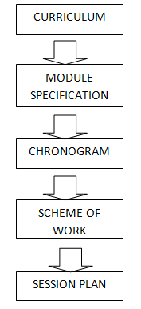
The following diagram shows steps to follow while planning

Slide 11
Definition of chronogram
Chronogram derives from the Greek words Chronos ("time") and gramma ("letter")meaning "time writing“
It is a calendar of modules sequence
Role of chronogram
Guide teaching (scheme based)
It is a school’s Timetable based
Helps trainers and trainees to know the sequence of modules within a trade
Inform trainers and trainees the period of integrated assessment
Help school administration and stakeholders to know the duration of each module within a trade
(Chronogram Template)
Chronogram year 1 FP

Slide 12
Topic: Description of a scheme of work
Definition
A scheme of work is a summarized forecast of work a trainer consider.
Role of a scheme of work
Guide teaching (session plans based)
Education authorities use scheme of work, to check the plan of logical sequence of instructional delivery
Ensures continuity in case of transfer of a trainer
Helps in strategic for utilization of teaching aids & reference material (preparation in advance)
Parts of a scheme of work template
Scheme of work sample

Slide 13
NOTE on scheme of work:
Every module has a scheme of work
All learning units of a module are described with their all learning outcome
Learning activities, learning resources and assessment tools are suggested in curriculum but the trainer should choose or change referring to his/her class environment.
Integrated situation (task and consumables)are applied only for specific modules

Slide 14
Topic: Prepare a session Plan
Topic: Description of a session plan
Definition
It is a detailed prior description of the learning session for a specified group of trainees
Road map showing how to reach set objectives
Role of session plan
Session plan gives a clear sense of :
What you are trying to accomplish
How you are going to accomplish it
How you know you have accomplished it

Slide 15
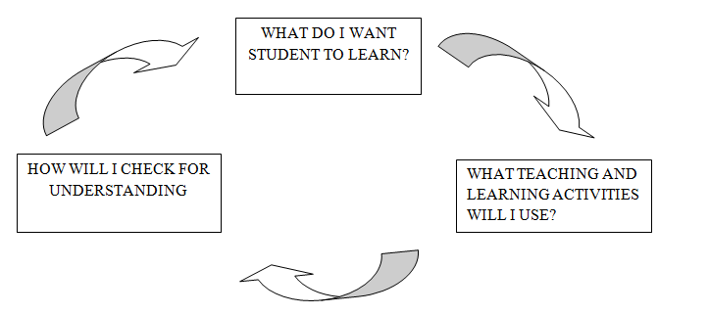
Session Plan includes:
Session Plan template
Session Plan sample

Slide 16
Prepare an inclusive session plan for a CBT session
Topic 1: Preparation of an inclusive session plan for a CBT session
Administrative details:
Sector , Sub-sector, Qualification title, RTQF Level, Date, Trainer’s name, Duration of session , Number of classes, Name of class, Number of trainees, Week of the session
Topic detail:
Module code and name, Competence, Learning unit, All Performance criteria of that LU: highlight the one concerned, Learning outcome

Slide 17
Activity
Preparation of a scheme of work for one of your module own trade:
Having all you need, elaborate a scheme of work for one of your module in own trade.

Slide 18
Topic: this come from the content (in curriculum) Example: use of question words
Range: this is apart of topic you are going to teach.
Example: using of how, why and when
Learning Place/Room Setting: when preparing a session plan, room arrangement should be show.
Example: U-shape, V-shape …
MART Objectives: each session plan must have at least three objectives and they must be SMART (Specific, Measurable, Achievable, Realistic, Time-bound).
Example: By the end of the lesson the Learner should be able to:Name appropriately seven types of lines used in domestic electrical drawing.

Slide 19
Stages of delivery of a SP
Introduction: in this stage, you describe how you will introduce the session, including greetings, taking roll call, warm up, introducing topic, set objectives, setting ground rules…
Development: this is the main stage as you describe how you will develop the session step by step, including facilitation techniques, formation of groups(if applicable), distributing tasks, monitoring way, work presentation, way of providing expert view…
Conclusion (Summary & Evaluation): in this stage, you describe how you will conclude the session, including summarizing the session, assessing way, evaluation of the session delivery process...
Assessment: the method to be used while assessing in this session is shown in this part.
Reference: all used documents should be listed in reference format

Slide 20
NOTE on session plan:
In all those stages (introduction, development, conclusion and assessment), you always allocate time to each of them, show the facilitator’s activity and the learner’s activity, key point of the content and mention resources you will use in delivery.
All materials to be used in the session (worksheets/task sheets/information sheets/notes for the facilitator....) must be attached as appendices.

Slide 21
Activity :
Using one module in your own trade, take at least one topic and prepare an inclusive session plan for a CBT session to deriver in 50 or 60 minutes.

